Slide 1


Kong Fu Panda --Po
Jerry and Jordan

Slide 2
Introduction
Po is working in a noodle shop. He wants to be a master of Chinese Kong Fu. There are many masters in his village. There is a tournament has been hold in the village. Po win the competition unexpectedly. This tournament’s winner need to expel the huge dragon. The five masters in his village disdain Po to be the winner of this tournament. The grand master teaches Po to be a top level warrior. Finally, the huge dragon comes. Po use his fighting skills defeats the dragon. The village become peaceful.

Slide 3
Po’s hero journey
1. Usual life | 6. Special Kong Fu skill
2. Unusual experience of tournament | 7. Villager escape
3. Difficulties of learning Kong Fu | 8. Po’s discovery
4. Unexpected discovery | 9. Po fight with evil
5. Mentor method | 10.Village return to peace

Slide 4
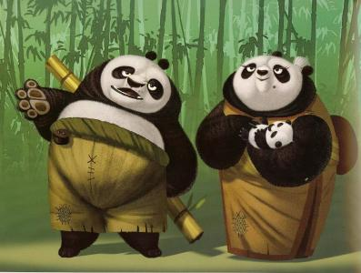
Usual life
Po is a worker in a noodle shop. He always think he could be a Kong Fu master.

Slide 5


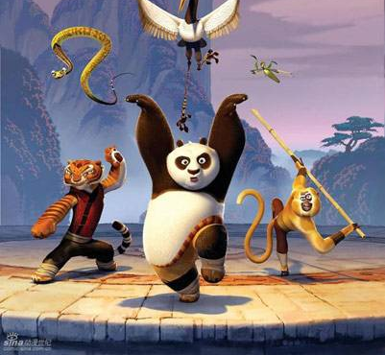
Unusual experience of tournament

Slide 6
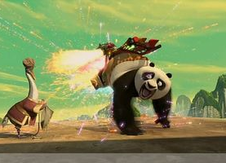
Difficulties of learning Kong Fu
Master raccoon is worried about evil dragon comes. Po does not have any Kong Fu skill. And Master raccoon tries many meth-ods to make Po to be a Kung Fu master.

Slide 7

Unexpected discovery

Slide 8
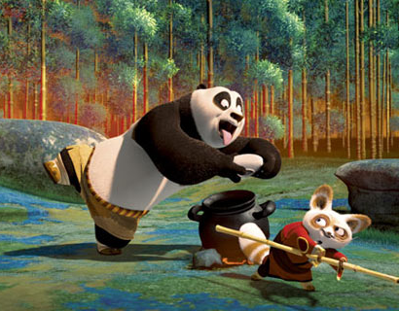
Mentor method
Master raccoon fi-nds Po's potency. He uses a special teaching skills to explore Po's pote-ncy.

Slide 9
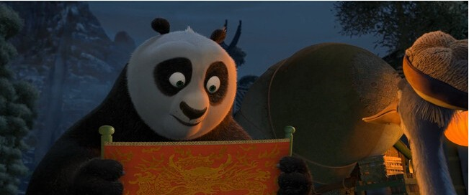
Special Kong Fu skill
Esoterica

Slide 10
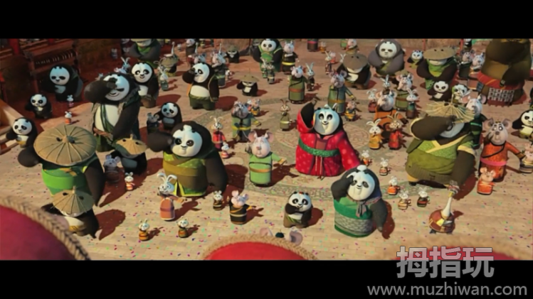
Villager escape
Master raccoon decides to let other people escape.
He wants to fight with big dragon

Slide 11
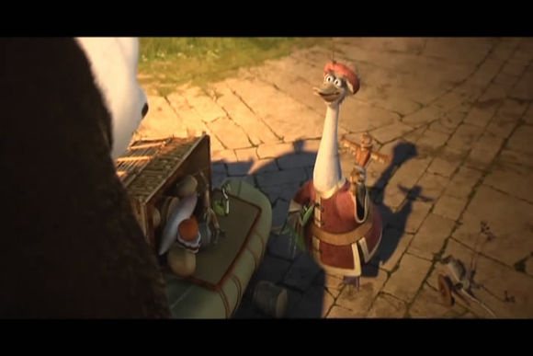
Po’s discovery
Self

Slide 12
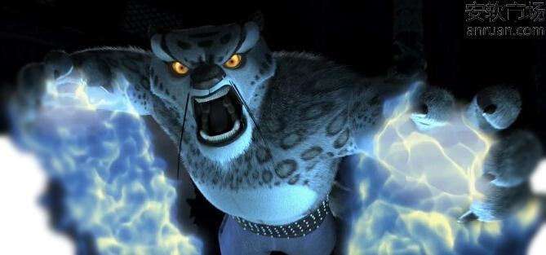
Po fight with evil
Po uses his Kung Fu skills and esoterica. Fighting with big dragon very hard.

Slide 13

Village return to peace
Hero

